Slide 1
Trie

Slide 2
Trie
A trie or prefix tree is a tree-like data structure whose nodes store the letters of an alphabet.
By structuring the nodes in a particular way, words and strings can be retrieved from the structure by traversing down a branch path of the tree.
Using a trie are a common approach to the storing/searching strings problem.
There are only 3 operations, that we can perform on tries:
Adding, finding and removing the strings.

Slide 3
Trie Inner representation
A trie usually contains a structure named Node. Node by itself contains an array of Node-s and some another useful variables.
In this example trie contains strings “ac” and “zyb”.
root
a
b
c
y
z
a
b
c
y
z
a
b
c
y
z
a
b
c
y
z
a
b
c
y
z
a
b
c
y
z

Slide 4
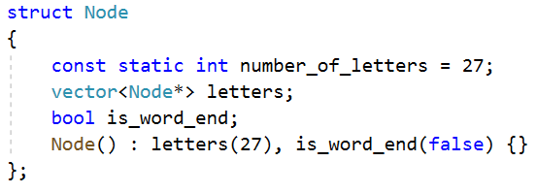

Trie Node structure
Node contains array of $k$ Nodes, where k is a number of letters in alphabet.
Possible implementation can be the following:

Slide 5
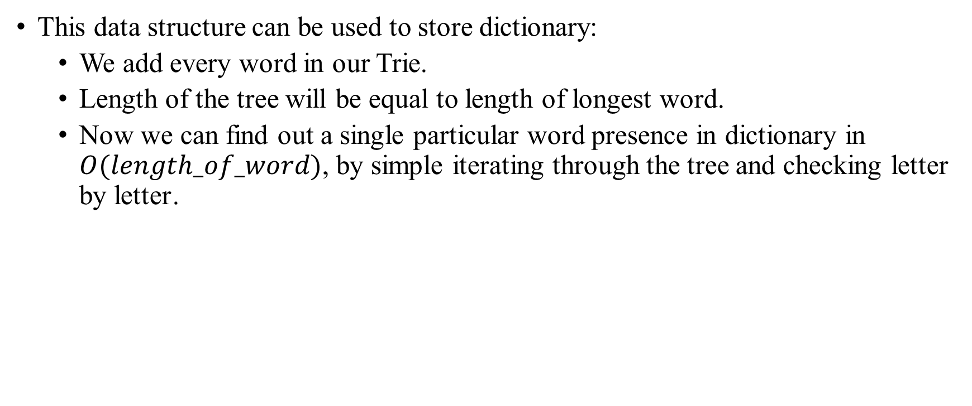
Trie Examples: Dictionary
This data structure can be used to store dictionary:
We add every word in our Trie.
Length of the tree will be equal to length of longest word.
Now we can find out a single particular word presence in dictionary in $O(length_of_word)$, by simple iterating through the tree and checking letter by letter․

Slide 6
Trie Other examples
Also this data structure can be used to:
Autocomplete the word by it’s prefix.
Find the words by substring.
Spell checking.
Automatic command completion.

